Slide 1
Housekeeping
Please respect the Code of Conduct
Handouts available in: github.com/The-Turing-Summer-Experience/intro-to-github
Use the post-its provided to let us know if you have a question or need help
Please ask questions on anything related to these topics!
https://github.com/alan-turing-institute/github-introduction, Zenodo at DOI: https://doi.org/10.5281/zenodo.12802974 CC-BY 4.0

Slide 2






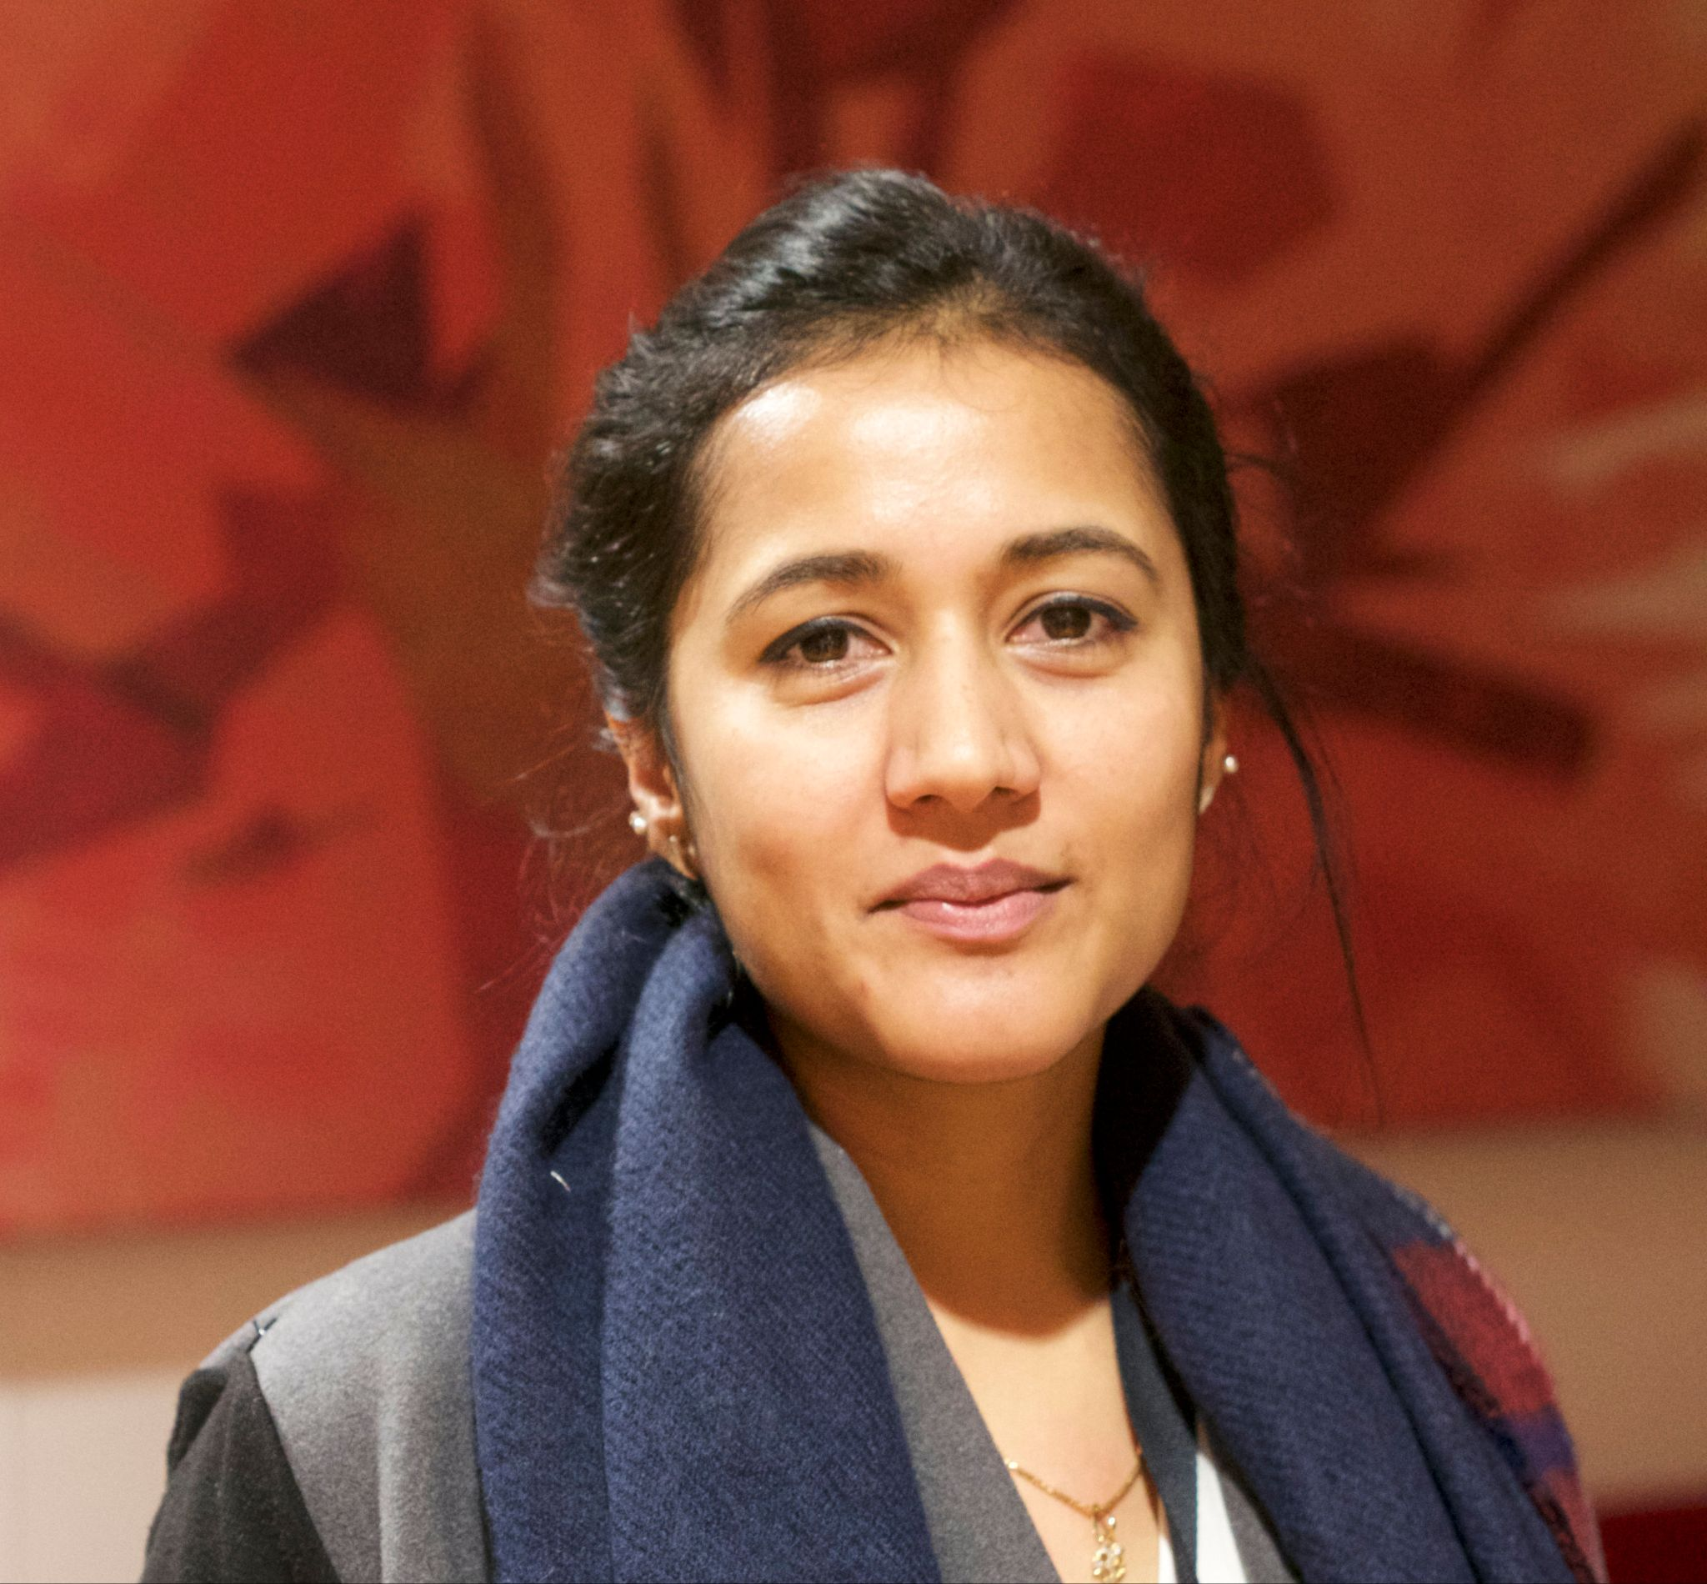
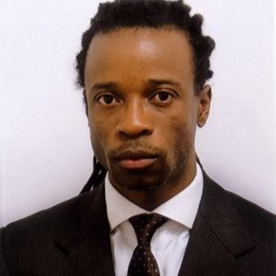
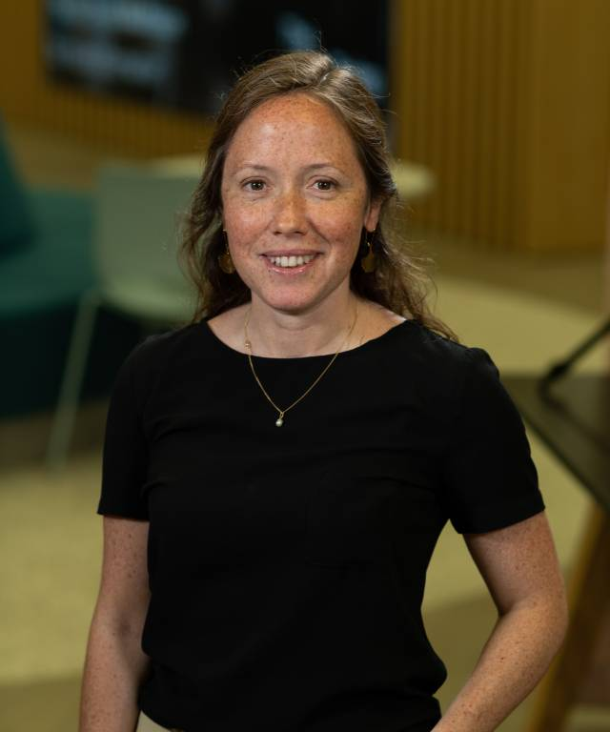

Git Good: an Introduction to GitHub for Collaboration
Online repo: https://github.com/The-Turing-Summer-Experience/intro-to-github All illustrations by Scriberia for The Turing Way community used under CC-BY 4.0 License
Zenodo at DOI: https://doi.org/10.5281/zenodo.12802974
Sophia Batchelor
Research Community Manager, AIM RSF
Cassandra Gould van Praag
Senior Research Community Manager, E&S
André Piza
Senior Research Community Manager, Arts & Humanities
Anne Lee Steele
Research Community Manager, The Turing Way
Vicky Hellon
Research Community Manager, Turing-Roche Partnership
Malvika Sharan Senior Researcher - Open Research, Co-Lead The Turing Way,
Lead RCM Team
Gabin Wilfried Kayumbi Senior Research Community Manager, DCE
Alexandra Araujo Alvarez Senior Research Community Manager, BridgeAI
Emma Karoune Senior Researcher, Research Community Building

Slide 3

Let’s Git Good:
Part 1: What is Git & Github?
Github Exercise 1: Finding an Issue and contributing to a project.
You will practice: Using issues to contribute and document decisions
Part 2: What is open source?
Github Exercise 2: Editing a file and making a Pull Request.
You will practice: Markdown; contributing, pull requests
Part 3: What can we make with Github?
Bonus Exercise 3: Make your own website

Slide 4
Let’s Git Good:
Part 1: What is Git & Github?
Github Exercise 1: Finding an Issue and contributing to a project.
You will practice: Using issues to contribute and document decisions
Part 2: What is open source?
Github Exercise 2: Editing a file and making a Pull Request.
You will practice: Markdown; contributing, pull requests
Part 3: What can we make with Github?
Bonus Exercise 3: Make your own website
Notes:
In the first part of today’s session - before we break for lunch, we’ll be talking through part 1.

Slide 5

Part 1: What is Git & Github?

Slide 6
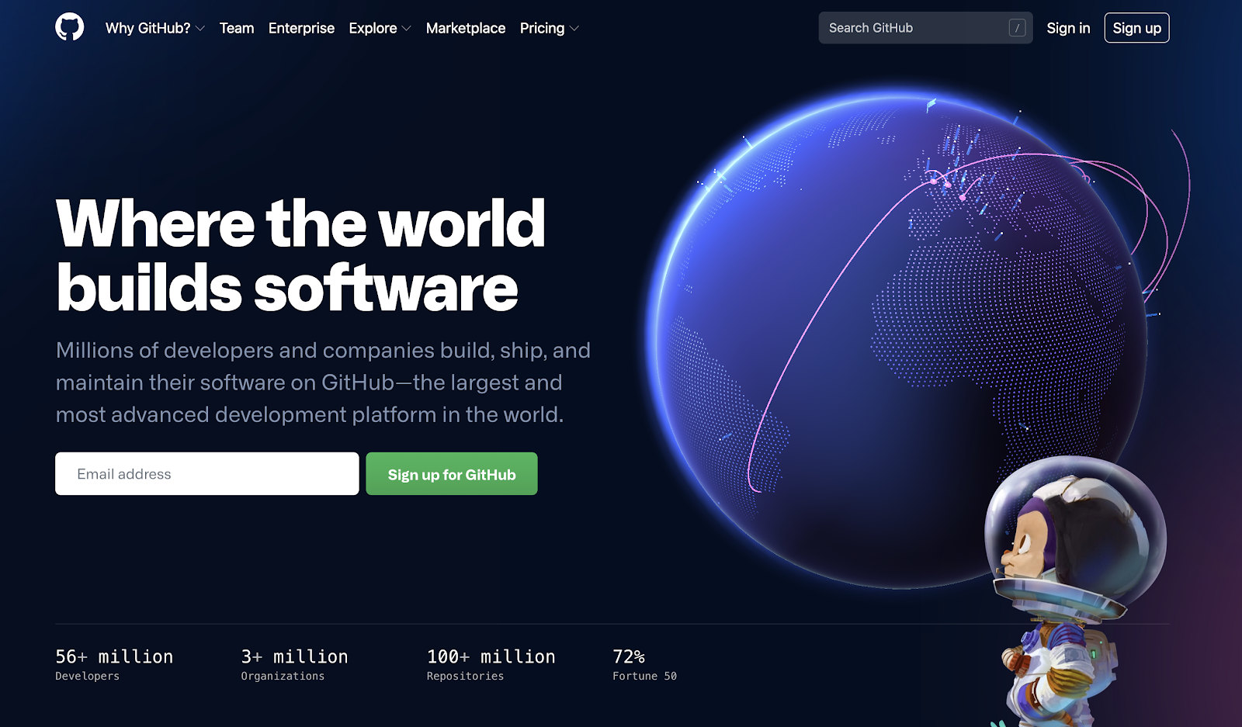
And version controlled documentation!
GitHub: https://github.com/
Notes:
Checking accounts & information
Working in pairs
You should have a dummy github account to use between the two of you - changed to they will use their own GH accounts
We’ll be using this over the next few hours.

Slide 7


Git & GitHub
Git is one of the most widely used software for version control. It is free and open source!
You can use git on your computer through the command line or a GUI.
GitHub is a popular service for hosting and sharing projects you have been tracking with git.
Flexible and securely control of access to materials, and open publishing.
Logos from GitHub and Git.
Notes:
Git is the coding language that can version control your software. It is free and open source. You use Git through a command line tool on your computer but you can also use it in a more friendly user interface.
GUI = graphical user interface
Github is one of the the user interfaces where you can use Git. It is can be access through your web browser and it uses Git to version control files. Github is an advanced versioning interface or tool.

Slide 8

Collaborative
Documents
There are challenges in developing collaborative documents…
What challenges might someone experience while developing collaborative documents?
Image. The Turing Way project illustration by Scriberia. Used under a CC-BY 4.0 licence. DOI: 10.5281/zenodo.3332807.¶
Notes:
There are lots of challenges to collaborating on documents as a distributed team.
To ask participants -> So what challenges might someone experience while developing collaborative documents?

Slide 9

Collaboration
Working together, often not at the same time or in the same place (distributed)
Challenges:
People editing the same line
Incorporating different ideas
Different versions of the doc
Time zones
Illustration by Scriberia for The Turing Way community used under CC-BY 4.0 License
Notes:
Often on research and software projects, we are working remotely with people in different locations and people working at different times of the day.
So the challenges are that we can edit the same line at the same time,
We need to incorporate different comments and ideas into the same document.
We might have different versions of one document that have been produces.
We might work at different times and need to incorporate our ideas at different times and at different stages of the document.

Slide 10
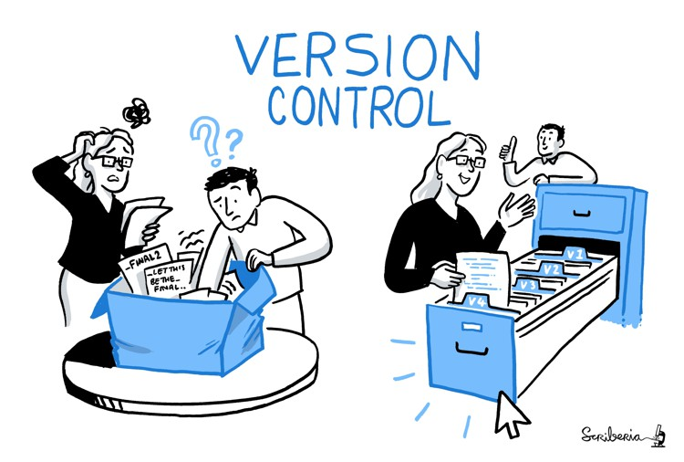
What is version control?
An approach to recording changes in a file over time so that you can:
track history
review specific changes
go to earlier/later versions (back up!)
Illustration by Scriberia for The Turing Way community used under CC-BY 4.0 License
Notes:
So version control is a way of recording changes in a file over time so you can track the history of changes, you can review specific changes, and you can go back in time to earlier versions and even revert to past versions of documents.
There are simple version control tools such as tracking histories in word and google docs but this does not keep as details a record as more advanced version control systems such as Git/Github.

Slide 11
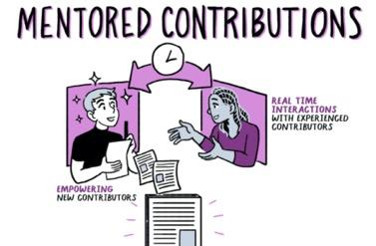
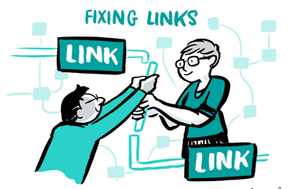

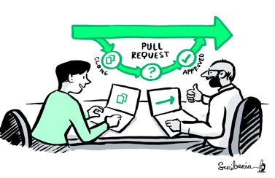
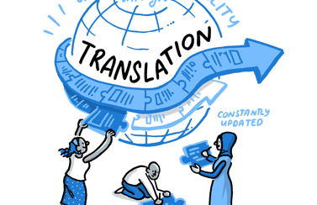

Making distributed collaboration possible
Attribution to contributors
Version control
Transparency & accountability
Reviewing & updating
Make it global
Project management
https://github.com/alan-turing-institute/the-turing-way, @turingway, CC-BY 4.0, DOI: 10.5281/zenodo.6997522.
Notes:
Collaboration can be really difficult!
We have to really consider how to collaborate in an inclusive manner so that everyone that wants to contribute can.
So in our project we help others to collaborate by:
mentoring people to contribute,
by using Github for version control,
by using an open source approach to make our project transparent and this also gives us accountability by everyone being able to see what we are doing in our project,
Our whole community is able to review and update our github repository,
We make our community globally inclusive by translating material into multiple languages
We also manage our project to be collaborative and document everything to help other understand it fully

Slide 12
Key Practices for Collaboration
Develop & share
Maintain & improve
Share resources
Review and update
Make it global
Share best practices
https://github.com/alan-turing-institute/github-introduction. Zenodo at DOI: https://doi.org/10.5281/zenodo.12802974, CC-BY 4.0
Notes:
Really our key practice for collaboration on our work is Git and Github – which we will be sharing more with you over the course of this afternoon.

Slide 13

Github Exercise 1: Commenting on an issue.
Go to the repository we’ve set up for this session.
Comment on the issue titled “Widening Participation - Session 1” to get started.
https://github.com/The-Turing-Summer-Experience/intro-to-github CC-BY 4.0. GIF from https://tenor.com/view/yoda-watch-and-learn-gif-15256521
Notes:
Distribute the handout
Open repository link “intro-to-github”
Now that we’ve explained a little bit about why we use these platforms, let’s dive right into an exercise!
Each computer you have should have have a github account associated with it. You should have received this information at the beginning of the session, but if you haven’t already, now it’s time to log into the account.
To get started on this issue, we’d like you to add a comment on the issue that lists two organisations, groups and/or companies that work with GitHub on the issue. We’ve given you a resource that might help, which lists government groups, companies, volunteer communities, non-profits, universities, and other organisations that use the platform.
On the issue, we’d like you to comment on the way in which the group uses github: do they use it for storing code? Conversations? Manuals? Policies?
Please let us know if you’re having any difficulty adding your information or discussion.
Online person is to: - comment in issue
Add all usernames to repo

Slide 14
Discussion
What do you think are the pros & cons of using a platform like Github?
https://github.com/The-Turing-Summer-Experience/intro-to-github
Notes:
That’s great folks! Now you’ve commented on your first issue (and contributed to your first issue), you’re a little more familiar with how Github might be used by different organisations and groups.
After doing this research, we’re curious to hear what you think: What do you think are the pros & cons of using a platform like Github?

Slide 15
How we will use Github this week
Github organisation: https://github.com/The-Turing-Summer-Experience
Use this organisation to:
View the schedule for the week
Participate in exercises
Document your progress
Illustration by Scriberia for The Turing Way community used under CC-BY 4.0 License
Notes:
Github will be a tool you use throughout this week. The Summer Experience team has uploaded the schedule.
You can use this organisation to view the schedule for the week, participate in exercises (like the ones we are doing together over the course of this session), as well as document your progress.
Feel free to explore this organisation using your Github username and the account you have been given for the week.

Slide 16

Questions?
https://github.com/alan-turing-institute/github-introduction. Image from Giphy. CC-BY 4.0.
Notes:
STOP FOR LUNCH (45 minutes)

Slide 17
Questions about Git & Github
Github is a website that is only used for code and working with codebases.
True or false?
Notes:
Let’s get started with a few questions about Git & Github.
False - you can store any type of file on github. It is used as working repositories for all sorts of research and software projects.

Slide 18
Questions about Git & Github
Github is a website that is only used for code and working with codebases.
True or false?
Notes:
False - you can store any type of file on github. It is used as working repositories for all sorts of research and software projects.

Slide 19
Questions about Git & Github
2. Github and Git are the same service.
True or false?
Bonus: Can you explain the difference between the two?
Notes:
False - Git is the language used for version control and Github is the interface that uses Git.

Slide 20
Questions about Git & Github
2. Github and Git are the same service.
True or false?
Bonus: Can you explain the difference between the two?
Notes:
False - Git is the language used for version control and Github is the interface that uses Git.

Slide 21
Questions about Git & Github
3. Collaborative practices on Github require version control to make sure everyone is editing the same information.
True or false?
Notes:
True - version control, or being able to keep track of all the different edits that have been made to a document or project can be really helpful for people working with complex projects on Github. Making sure that everyone is is working with the same information can be really helpful to make this a less confusion process.

Slide 22
Questions about Git & Github
3. Collaborative practices on Github require version control to make sure everyone is editing the same information.
True or false?
Notes:
True - version control, or being able to keep track of all the different edits that have been made to a document or project can be really helpful for people working with complex projects on Github. Making sure that everyone is is working with the same information can be really helpful to make this a less confusion process.

Slide 23
Questions?
(now we break for lunch!)
https://github.com/alan-turing-institute/github-introduction. Image from Giphy. CC-BY 4.0.
Notes:
STOP FOR LUNCH (45 minutes)

Slide 24
Let’s Git Good:
Part 1: What is Git & Github?
Github Exercise 1: Finding an Issue and contributing to a project.
You will practice: Using issues to contribute and document decisions
Part 2: What is open source?
Github Exercise 2: Editing a file and making a Pull Request.
You will practice: Markdown; contributing, pull requests
Part 3: What can we make with Github?
Bonus Exercise 3: Make your own website using Github
Notes:
In this second part, we’ll be working through part 2 and part 3.

Slide 25
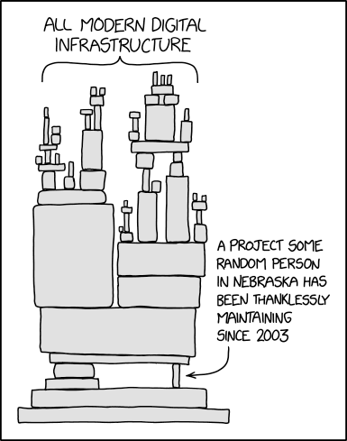
Part 2: What is open source?
Open source software!
xkcd, ‘Dependency’: https://xkcd.com/2347/
Notes:
Now that we’ve talked a bit about Git & Github, now we can talk about open source.
You all surf websites and use the internet almost every day. Open source software, or bits of code that have been edited and refined by groups of people together and online, is underlines a lot of what we use today, even though it might be invisible to the average user.
This is a comic from an artist called xkcd, which illustrates just how reliable digital infrastructure is on open source software is on the developers that maintain the code.

Slide 26
“Open source software is software that can be freely used, modified, and shared (in both modified and unmodified form) by anyone.”
- GitHub Glossary, Open Source
Ways of working (collaborative practices for working together)
Technical requirements (like Git & Github)
Licenses (like creative commons)
Notes:
As we were saying, open source software is what underlies a lot of our modern digital infrastructure, both online and offline. This definition, taken from Github’s own glossary defines Open Source as “software that can be freely used, modified, and shared (in both modified and unmodified forms).
We’ll be breaking down this definition a little bit more this afternoon.
In the first session, we talked a bit about the ways of working behind collaborative work online, and the technical requirements and tools behind it, with platforms like Github.
Now we’ll talk a little bit more about the legal frameworks that allow this kind of collaborative work, such as the creative commons license.
We have already talk

Slide 27




What is open source?
Roots in free software movement
Licensing allowed for modifications and derived works
Developed into free and open source software (F/OSS) movement
Influenced ‘open’ movements: open knowledge, open data, open access, open science
Notes:
As Vicky was saying, The Turing Way is a product of – and belongs to – our community of contributors. This means that it’s open by design, and collaborative in practice. In real time, this means that we use open source tools & methods to collaborate, and open framework for collaboration, peer production and project sustainability – so that users collaborate to build resources that are beneficial for them.
Ultimately, this means that we aim to be open all the way down. In fact, we would argue that The Turing Way has grown within a short amount of time because it has been designed to be open.

Slide 28
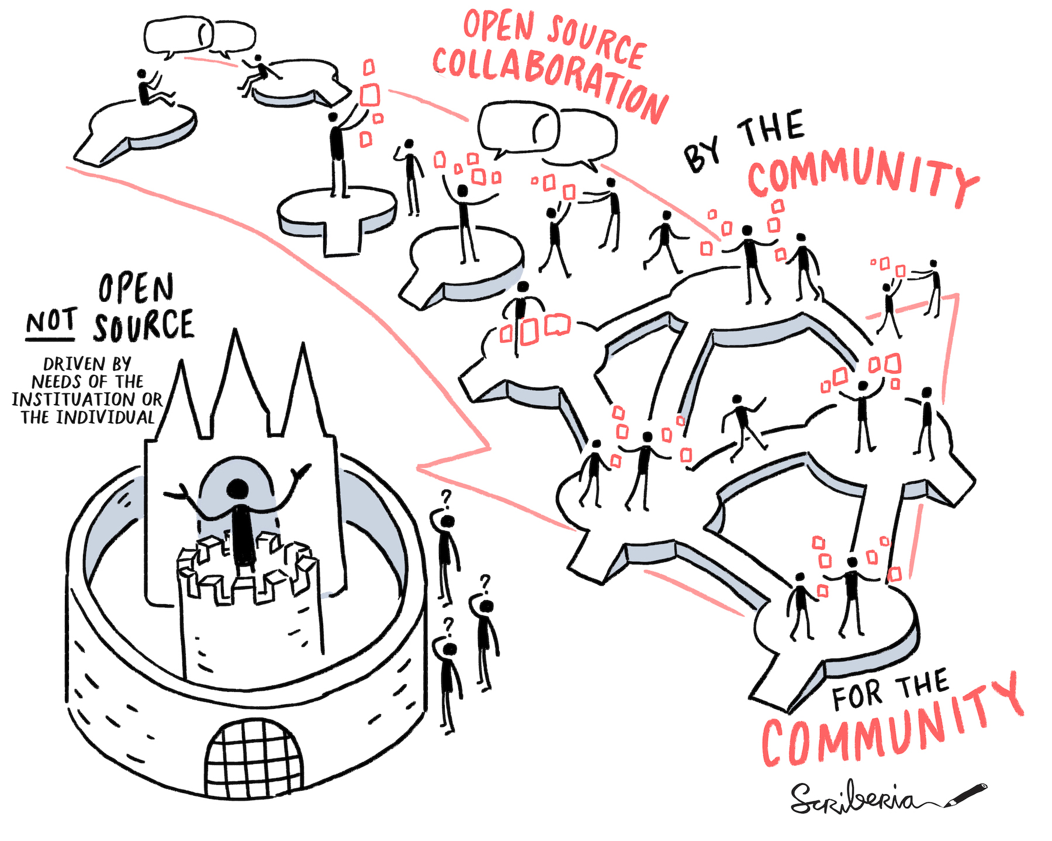
Open source collaboration
Notes:
As Vicky was saying, The Turing Way is a product of – and belongs to – our community of contributors. This means that it’s open by design, and collaborative in practice. In real time, this means that we use open source tools & methods to collaborate, and open framework for collaboration, peer production and project sustainability – so that users collaborate to build resources that are beneficial for them.
Ultimately, this means that we aim to be open all the way down. In fact, we would argue that The Turing Way has grown within a short amount of time because it has been designed to be open.

Slide 29
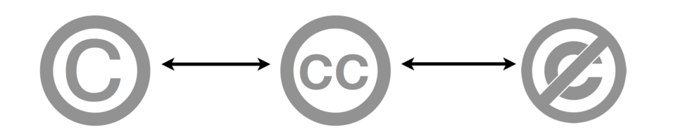
Licenses and Copyright
Copyright All Rights Reserved Re-use requires the permission from the copyright owner
Open Licenses
Some Rights Reserved Re-use is permitted without permission under the specifications of the license
Public Domain
No Rights Reserved May be used without permission
Notes:
How many of you have heard about any of these terms: copyright? (hands) open licenses? (hands) public domain? (hands)
Licenses and copyright are really important - because they’re the legal framework that shapes how people can use your material online or offline, which is called ‘intellectual property’. Don’t worry - this isn’t a law class! But, we will explain a bit about why these licenses are so important.
You might have heard of copyrights, or see the copyright symbol with the phrase “all rights reserved” next to it. This means that using the materials that are copyrighted require permission from the owner, they have what are called ‘exclusive rights’ over material.
On the other hand, you might have heard of work in the “public domain”. This means that there is no copyright of intellectual property law can be used, and that this material can be used without any permission from any entity or organisation.
Today, we’re going to be focused specifically on open licenses - which lie somewhere in the middle between copyright and the public domain.
We are by no means experts – but we’ll give you a brief overview of licenses and software that might help you think through this important part of collaborating openly.

Slide 30
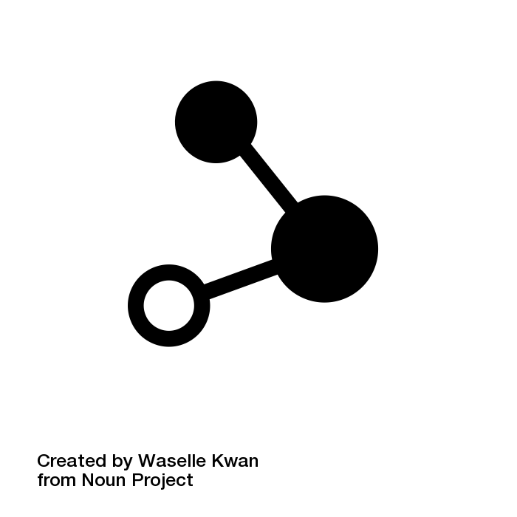


Open Licenses
use
Anyone can use the work for any purpose
modify
Anyone can modify the work
share
Anyone can redistribute both the original and modified work
Examples:
Creative Commons, MIT license
https://github.com/alan-turing-institute/github-introduction. Zenodo at DOI: https://doi.org/10.5281/zenodo.12802974, CC-BY 4.0
@openlifesci, CC-BY 4.0, The Turing Way, DOI: 10.5281/zenodo.7684733
Notes:
As Open Leaders, we want to be as permissive as possible, and allow others to freely use, modify, and share our work.
Open licenses allow people to use materials, modify them, or share and redistribute their work. There are many different types of licenses, which we have listed started on page 10 of the handout.
We’re not going to talk about every type of license here, but you can learn more on our handout, starting on page 10.
Has anyone heard of the Creative Commons license? (hands) or MIT licenses? (hands)

Slide 31
Questions?
https://github.com/alan-turing-institute/github-introduction. Image from Giphy. CC-BY 4.0.
Notes:
Brief pause for questions

Slide 32

Exercise
What do you think the project’s license is & why?
https://github.com/alan-turing-institute/github-introduction. Zenodo at DOI: https://doi.org/10.5281/zenodo.12802974, CC-BY 4.0
Notes:
It might be easier to think through a few examples.
Here’s a screenshot of Mickey Mouse from the famous 1928 animation called Steamboat Willy. What do you think the project’s license is and why?
Don’t forget, your options are: copyright, open license, and public domain. You can use your handout as a reference as well on page 10 of your handout.
(Pause for discussion)
This version of the famous cartoon character is in the public domain. In the United States, exclusive copyrights have a time limit, and generally expire either 70 years after the author’s death or 95 years after original publication. For this early Mickey Mouse, the right to use this illustration expired 95 years after the drawing was first released in 1928, which meant that it expired in January 2024 - earlier this year.
This means that “Mickey Mouse 1.0” can be used for for all sorts of different uses, without asking Disney for permission. While more recent illustrations of the famous character are still protected under copyright, this has already spawned different creative projects!

Slide 33
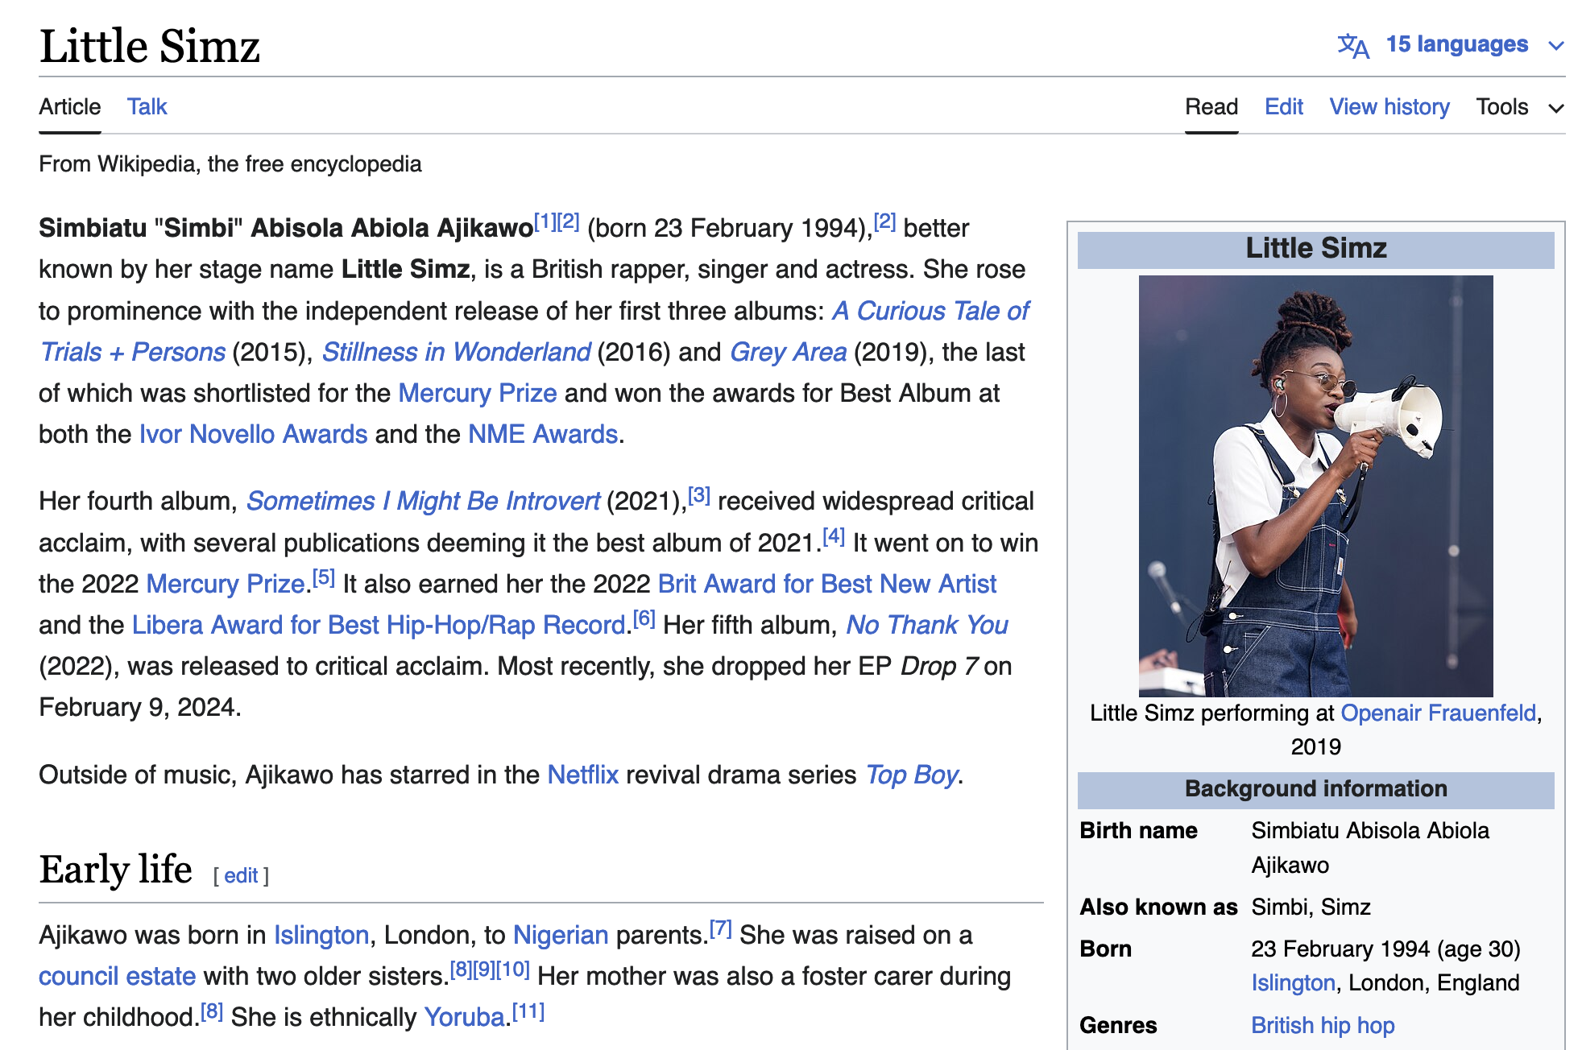

Exercise
What do you think is this project’s license is & why?
https://github.com/alan-turing-institute/github-introduction. Zenodo at DOI: https://doi.org/10.5281/zenodo.12802974, CC-BY 4.0
Notes:
Who here has used Wikipedia? (hands)
What do you think is the license for Wikipedia, and why?
(Pause for discussion)
Everything published on Wikipedia, the giant crowdsourced encyclopedia we often learn more about topics that are of interest to us, uses the Creative Commons licenses, specifically the CC BY-SA license. You can learn more about what this means on page 11 of your handouts, but generally, this means that you can remix, change, or build upon the materials posted on the website.
All of Wikipedia uses this license: from the text, to photos, to videos, to everything in between.
You can see a little tip - this image on the first screenshot has the license listed on the bottom right hand corner of the image, which is CC BY-SA.
This means that everything on Wikipedia can be remixed, tweaked, and built upon even for commercial purposes, as long as you credit the creator. This is what allows Wikipedia to be a source you often see on applications and websites.

Slide 34

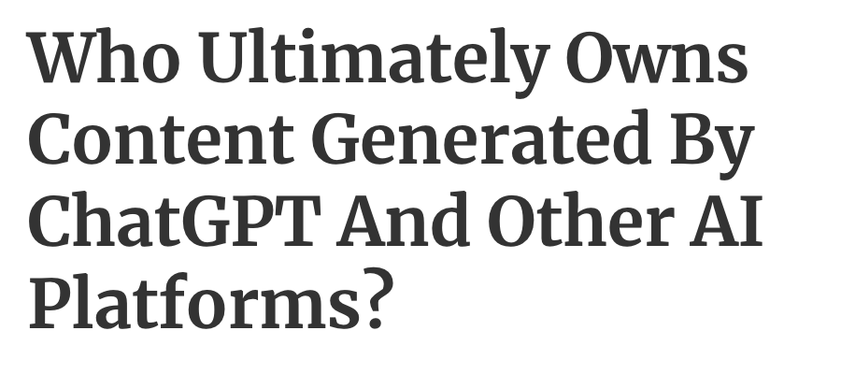

Licenses and
21st century media
How do you think licenses work
https://github.com/alan-turing-institute/github-introduction. Zenodo at DOI: https://doi.org/10.5281/zenodo.12802974, CC-BY 4.0
Notes:
Of course, when these licenses were originally made, they didn’t know about the types of media we would have at our fingertips in the 21st century.
For example: for your average Tiktok or Instagram reel, does the copyright apply to the song? Dance? Image?
Source: https://www.trackclub.com/resources/tiktok-copyright-music-what-creators-need-to-know/

Slide 35
Licenses and
21st century media
What are the ways you would or wouldn't like your work to be used, modified, or shared?
By who?
https://github.com/alan-turing-institute/github-introduction. Zenodo at DOI: https://doi.org/10.5281/zenodo.12802974, CC-BY 4.0. GIF from https://tenor.com/view/spinning-dive-paola-espinosa-sanchez-olympics-magnificent-dive-high-dive-gif-22567002
Notes:
What are ways that you would or wouldn’t like your work to be used, modified or shared?
Is there a time, place or type of content where you wouldn’t want to be copied or used by others?
For example: for me, I would like my blogs to be modified or shared. However, I wouldn’t like the photos I have posted on my Facebook from 10 years ago modified for shared.

Slide 36
Open source collaboration → enabled by open licenses
Notes:
Open source collaboration is something that is enabled by these licenses. We won’t expect you to memorise all the types, of course. But it’s important to keep them in mind when you make and upload work online in any form.

Slide 37
Open Source Exercise
We have 5 case studies of open source projects.
What is the project’s license?
Why do you think this license benefits this project?
What platform do they host their code on?
https://github.com/alan-turing-institute/github-introduction. CC-BY 4.0. GIF from https://tenor.com/view/yoda-watch-and-learn-gif-15256521
Notes:
One handout we gave you has 5 different case studies: projects that use open source frameworks.
Using the handouts we’ve given you and your own research, we’d like you to answer the following questions.
As you do this research, we’d like you to share what you’ve learned about your case study through a pull-request.

Slide 38

GitHub Exercise 2: Edit a file and make a Pull Request.
Go to repository ‘intro-to-github’
Go to the file labelled introductions in the file ‘github-workshop’
Edit the file and write about your your case study.
Commit the change and submit a Pull Request.
https://github.com/alan-turing-institute/github-introduction. Zenodo at DOI: https://doi.org/10.5281/zenodo.12802974, CC-BY 4.0. GIF from https://tenor.com/view/spinning-dive-paola-espinosa-sanchez-olympics-magnificent-dive-high-dive-gif-22567002
Notes:
[ Share screen and walk people through the steps - demo ]
Not doing forking!

Slide 39
GitHub Exercise 2:
Make a Pull Request to the Main Repository
5. A maintainer will review your PR and approve it!
6. Merge your PR when approved.
https://github.com/alan-turing-institute/github-introduction. Zenodo at DOI: https://doi.org/10.5281/zenodo.12802974, CC-BY 4.0. GIF from https://tenor.com/view/spinning-dive-paola-espinosa-sanchez-olympics-magnificent-dive-high-dive-gif-22567002

Slide 40
Questions?
https://github.com/alan-turing-institute/github-introduction. Image from Giphy. CC-BY 4.0.

Slide 41
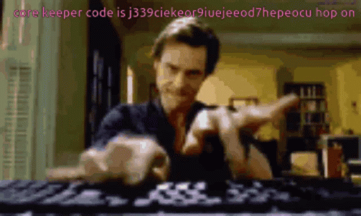
Part 3: Getting good with Github (applied exercises and more!)
https://github.com/alan-turing-institute/github-introduction. Zenodo at DOI: https://doi.org/10.5281/zenodo.12802974, CC-BY 4.0. GIF from https://tenor.com/view/spinning-dive-paola-espinosa-sanchez-olympics-magnificent-dive-high-dive-gif-22567002
Notes:
Now, we don’t have a lot of time, but if you’d like to push yourself a little further, there’s a bit more that we can do!

Slide 42

GitHub Stretch Exercise 1: Create a new repo
Create a repo
Edit your README.md
Add a license
Open an issue
https://github.com/alan-turing-institute/github-introduction. Zenodo at DOI: https://doi.org/10.5281/zenodo.12802974, CC-BY 4.0. GIF from https://tenor.com/view/spinning-dive-paola-espinosa-sanchez-olympics-magnificent-dive-high-dive-gif-22567002

Slide 43
Use your case studies from the previous exercise to create a repository
Learn more about your case study project, and instances where it might have been used. Share this on your repository.
Find a project that uses the software, project, or principles described in the case study and share it through your repository
Have other ideas? (Check with your instructor!)
https://github.com/alan-turing-institute/github-introduction. Zenodo at DOI: https://doi.org/10.5281/zenodo.12802974, CC-BY 4.0. GIF from https://tenor.com/view/spinning-dive-paola-espinosa-sanchez-olympics-magnificent-dive-high-dive-gif-22567002
Notes:
Now that you’ve created your own repository, you can use the case studies that you worked with for the previous exercise to make a related repository.

Slide 44
GitHub Stretch Exercise 2: Create a Github webpage
Convert into a Github webpage!
https://github.com/alan-turing-institute/github-introduction. Zenodo at DOI: https://doi.org/10.5281/zenodo.12802974, CC-BY 4.0. GIF from https://tenor.com/view/spinning-dive-paola-espinosa-sanchez-olympics-magnificent-dive-high-dive-gif-22567002

Slide 45

So you’ve learned how to contribute to an open source project…
Is there anything you would you like to use Github for in the future?
https://github.com/alan-turing-institute/github-introduction. Zenodo at DOI: https://doi.org/10.5281/zenodo.12802974, CC-BY 4.0. GIF from https://tenor.com/view/spinning-dive-paola-espinosa-sanchez-olympics-magnificent-dive-high-dive-gif-22567002

Slide 46
Questions?
https://github.com/alan-turing-institute/github-introduction. Image from Giphy. CC-BY 4.0.

Slide 47
Acknowledgements
The Brilliant Club, support staff, Ayesha Magill and Juliette Sexton.
Kirstie Whitaker, Malvika Sharan, The Turing Way community, friends & collaborators
Sophia Batchelor, Malvika Sharan, Cass Gould van Praag, Emma Karoune, Eirini Zormpa, Gabin Kayumbi, Anne Lee Steele, Andre Piza, Alexandra Araujo Alvarez, Vicky Hellon.
GitHub workshop based on Friendly GitHub Intro by Kirstie Whitaker, GitHub Collaborating Document by Malvika Sharan & GitHub for Collaboration by Sophia Batchelor.
Original artwork by Scriberia: https://doi.org/10.5281/zenodo.3332807
https://github.com/alan-turing-institute/github-introduction. Zenodo at DOI: https://doi.org/10.5281/zenodo.8221283, CC-BY 4.0.

Slide 48
